Slide 1
Linked Lists

Slide 2
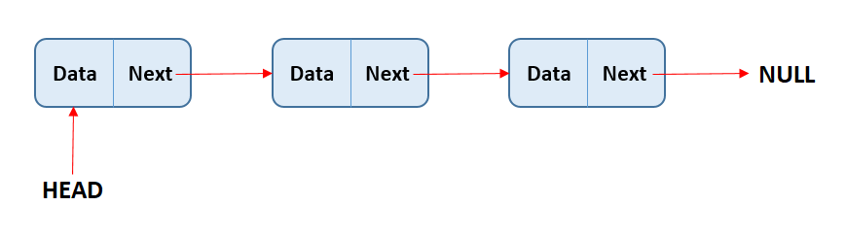
Introduction
A linked list is a linear data structure where each element (node) contains a data part and a reference (or link) to the next node in the sequence.

Slide 3
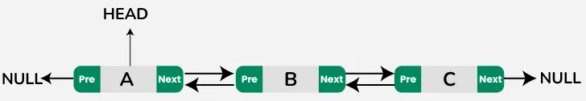
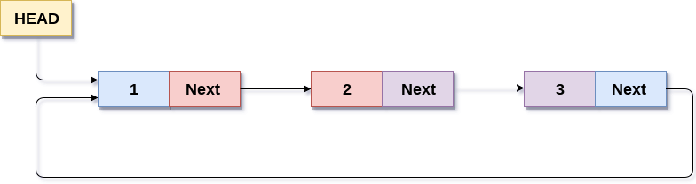
Types of Linked Lists
Singly Linked List:
Each node points to the next node.
Last node points to NULL
Doubly Linked List:
Each node points to both the next and previous nodes.
Allows traversal in both directions.
Circular Linked List:
Last node points back to the first node, forming a circle.
Can be singly or doubly linked.

Slide 4
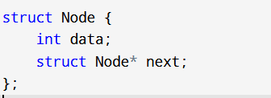
Node Structure
Components:
Pointer/Link: The reference to the next node in the list.
Data: The value stored in the node.

Slide 5
Basic Operations on Linked Lists
Creation
Initializing an empty list.
Allocating nodes dynamically.
2. Insertion
At the beginning, end, or after a specific node
Adjusting pointers accordingly.
3. Deletion
Removing nodes from the beginning, end, or a specific position.
Managing memory deallocation.
4. Traversal
Visiting each node in the list to process data.

Slide 6
Advanced Operations
Reversal
Concatenation
Searching
Sorting

Slide 7
Advantages of Linked Lists
Dynamic Size: Linked lists can grow and shrink in size dynamically.
Efficient Insertions/Deletions: Unlike arrays, linked lists can easily insert or delete nodes without shifting elements.
No Wasted Memory: Linked lists allocate memory as needed, avoiding wasted space.

Slide 8
Disadvantages of Linked Lists
Memory Overhead: Extra memory is required for storing pointers.
Slower Access: Random access is not possible; traversal is required to access an element.
Complexity: More complex to implement than arrays due to pointer management.

Slide 9
Applications of Linked Lists
Dynamic Memory Allocation: Managing memory in operating systems.
Implementing Stacks and Queues: Used in data structures like stacks, queues, and graphs.
Polynomial Arithmetic: Used to store coefficients of polynomials for efficient operations.

Slide 10
Real-World Example
Music Playlist
Image Viewer
Web Browser History
Undo/Redo Functionality in Text Editors
Implementation of Queues in Printers

Slide 11
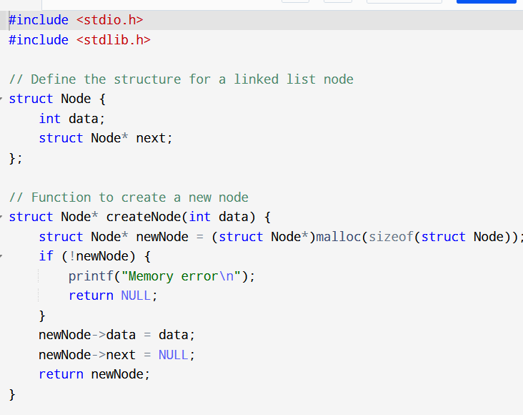
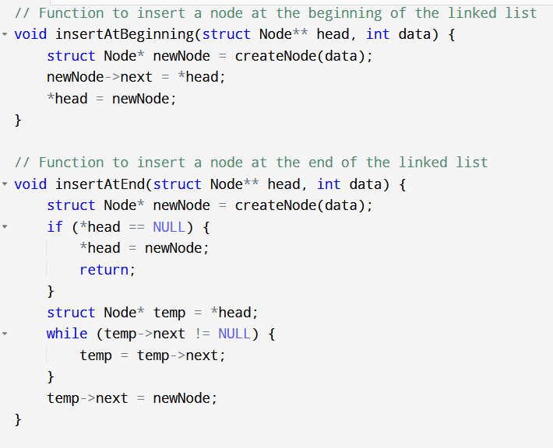
Linked list code

Slide 12
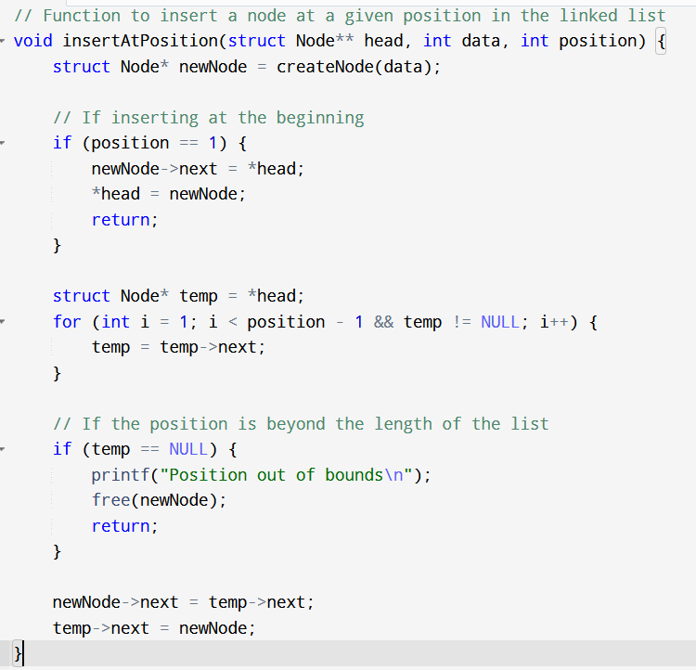
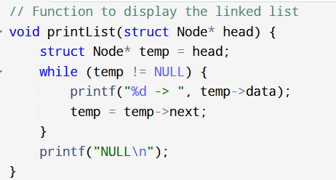

Slide 13
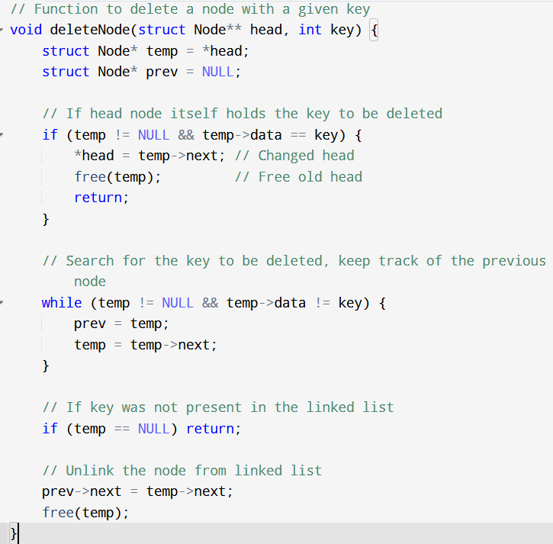

Slide 14
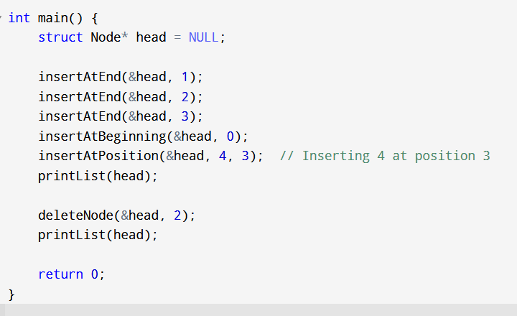

Slide 15
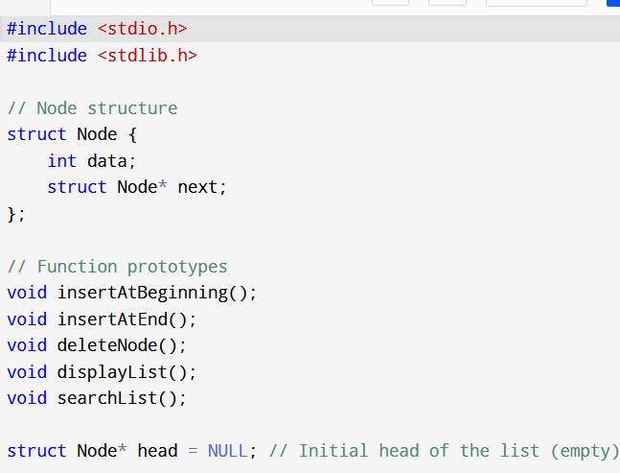
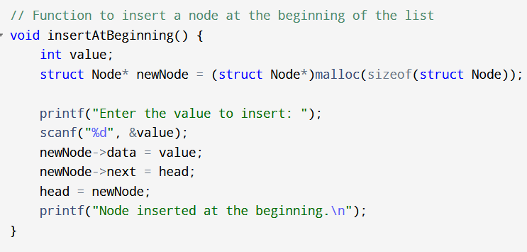
Menu Driven Program of Singly Linked List

Slide 16
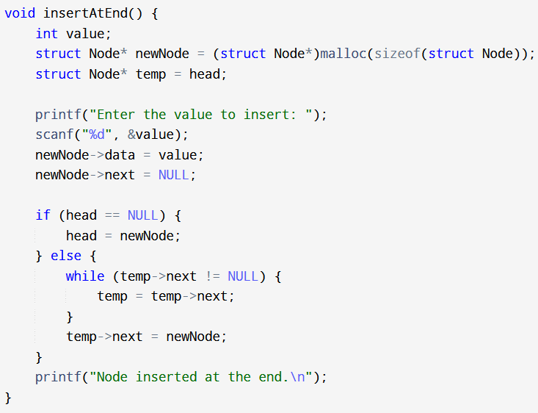

Slide 17
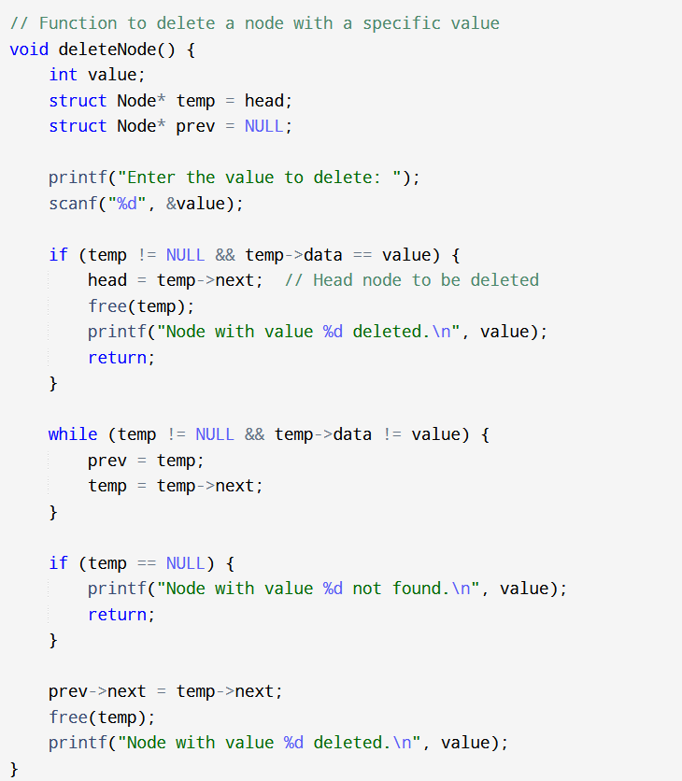

Slide 18
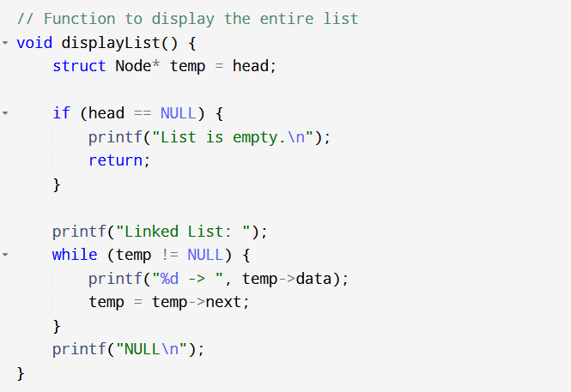
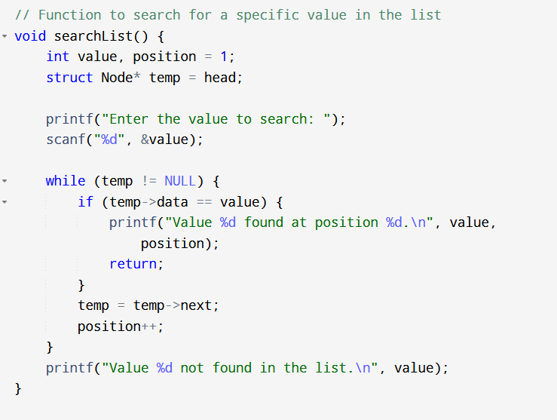

Slide 19
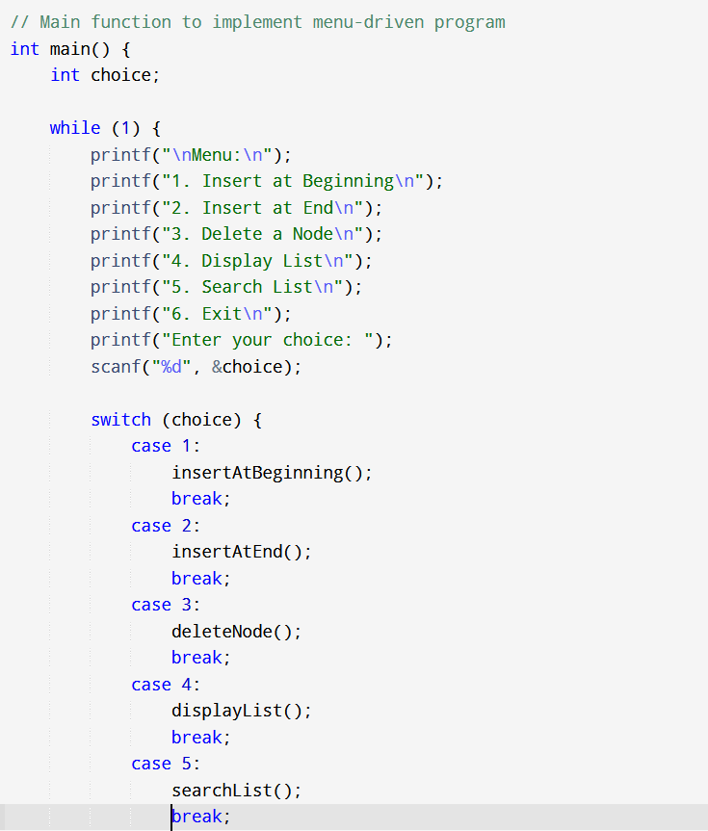
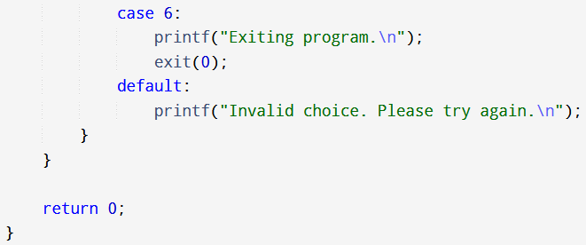

Slide 20
What is a Doubly Linked List?
Definition
A linked list where each node points to both the previous and the next node.
Structure of a Node:
Data: Stores value.
Previous Pointer: Points to the previous node.
Next Pointer: Points to the next node.

Slide 21
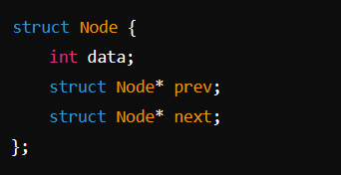
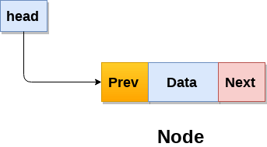
Node Structure in C
data: Stores the element.
prev: Points to the previous node.
next: Points to the next node.

Slide 22
Advantages of Doubly Linked List
Allows both forward and backward traversal.
Easier deletion of a node compared to singly linked list.
More flexible for complex data structures (e.g., deque, navigation systems).

Slide 23
Disadvantages
Requires more memory due to extra pointer.
Slightly more complex than a singly linked list.

Slide 24
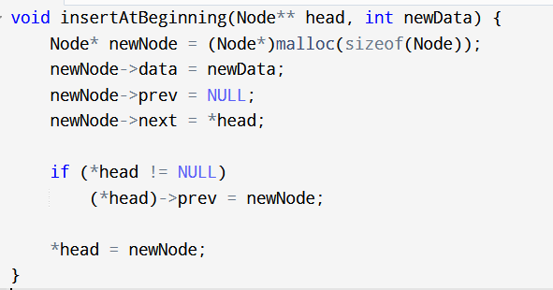
Insertion at Beginning

Slide 25
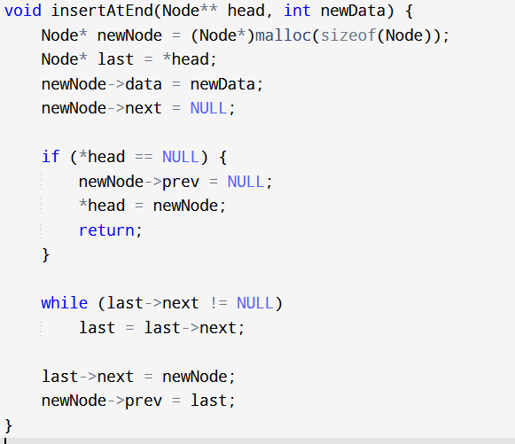
Insertion at End

Slide 26
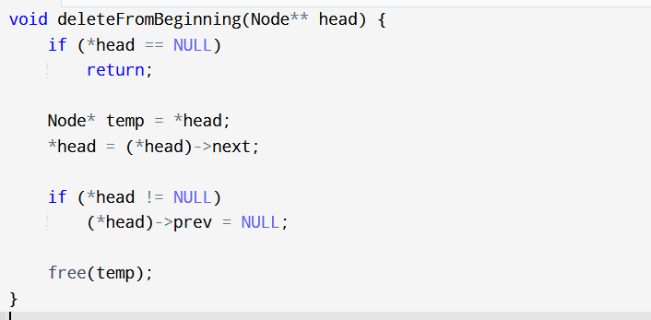
Deletion from Beginning

Slide 27
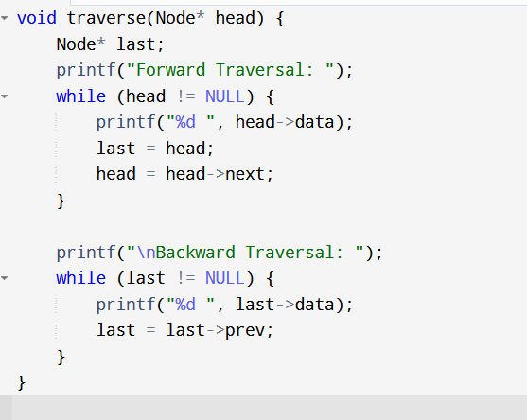
Traversal of Doubly Linked List

Slide 28
What is a Circular Linked List?
Definition
A circular linked list is a linked list where the last node points to the first node, forming a circle.
Structure of a Node:
Data: Stores value.
Next Pointer: Points to the next node.

Slide 29
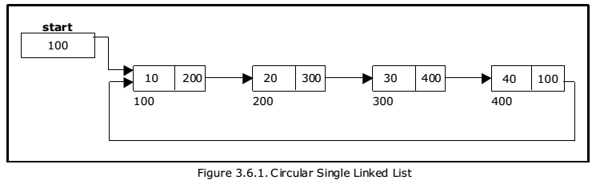
Node Structure in C

Slide 30
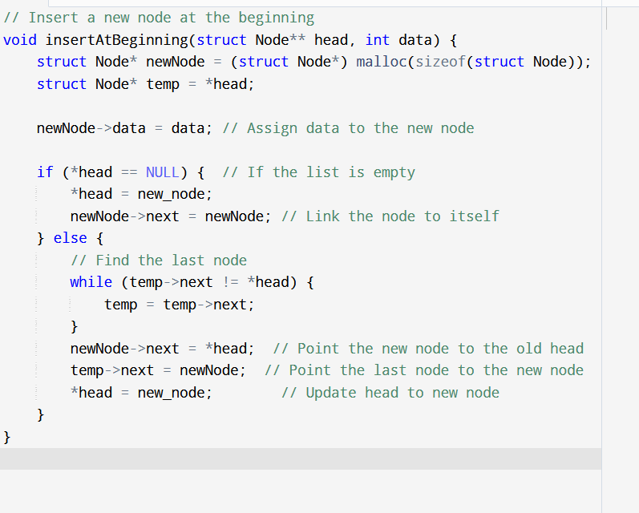
Insertion at the beginning

Slide 31
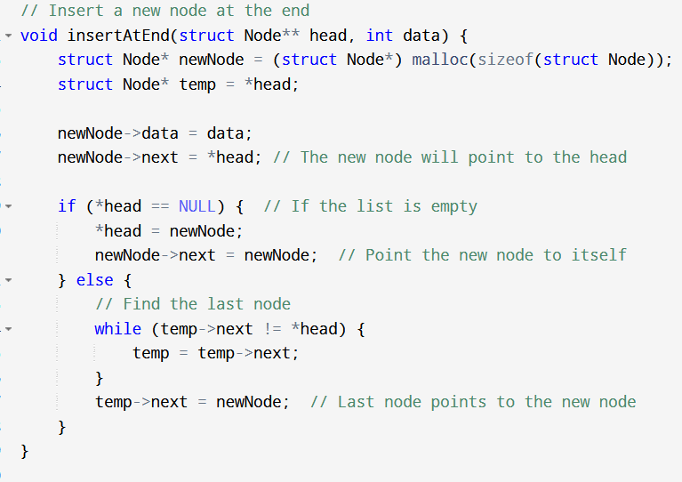
Insert at the end

Slide 32
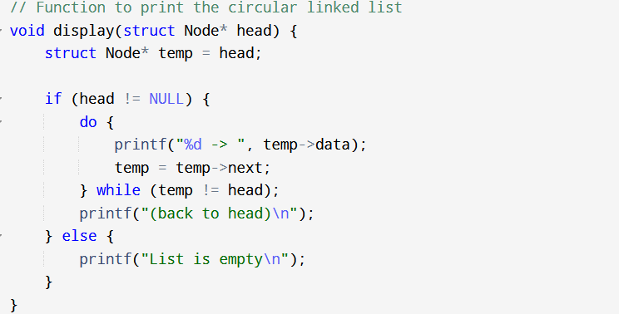
Traversing of List

Slide 33
Difference between singly and circular linked list
Feature | Singly Linked List | Circular Linked List
End Connection | Last node points to NULL. | Last node points to the first node.
Traversal | Ends when NULL is encountered. | Continues indefinitely in a loop.
Memory Usage | Requires a NULL pointer at the end. | No NULL, but needs extra management for circularity.
Applications | Used in linear structures (stacks, queues). | Used in circular processes (e.g., round-robin scheduling).
Complexity of Operations | Simple, straightforward. | Requires careful handling to maintain the loop.
Insertions/Deletions | Easier to implement at ends. | Requires adjustments to maintain circular links.

